Slide 1
Rejuvenate JIRA
Mallikarjunarao K

Slide 2

Idea
Could we do automate JIRA/Bug verification/retest process?
Yes, We will do.
How?
Using JIRA REST(Representational state transfer) APIs.
Notes:
Representational state transfer http://en.wikipedia.org/wiki/Representational_state_transfer
JIRA REST API https://developer.atlassian.com/display/JIRADEV/JIRA+REST+API+Example+-+Add+Comment

Slide 3
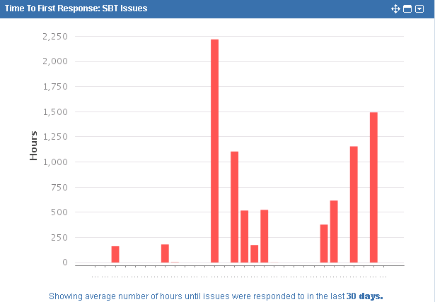
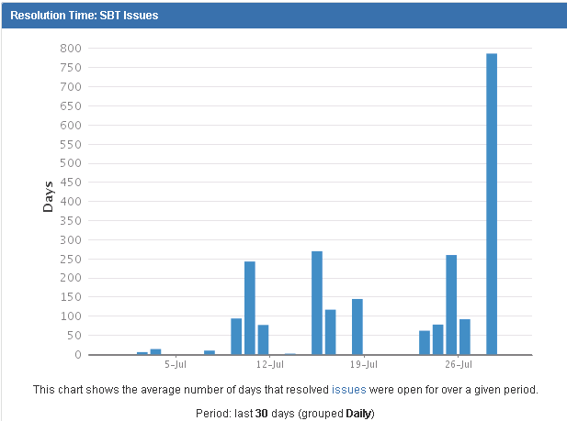
Real Problem
Few of Minor JIRA have been taking more hours to respond on that Issue or JIRA, and also Resolution Time also increasing due to this issue.
Because, there were other major/critical issues were lagging behind. with help of this tool we could able retest of the JIRA.

Slide 4
How Rejuvenate
Step 1
Step 2
Download pvt file from JIRA, and input it to iTest
Step 3
iTest will do necessary operation to retest JIRA
Publish brief comment to JIRA{id} about JIRA status
Upload PVT (Provisioning and Verification Tool) file as an attachment while creating JIRA.
Notes:
PVT http://saniti-testing.test.adtran.com/projects/saniti/wiki/pvtWiki
REST JIRA API https://developer.atlassian.com/display/JIRADEV/JIRA+REST+API+Example+-+Add+Comment

Slide 5
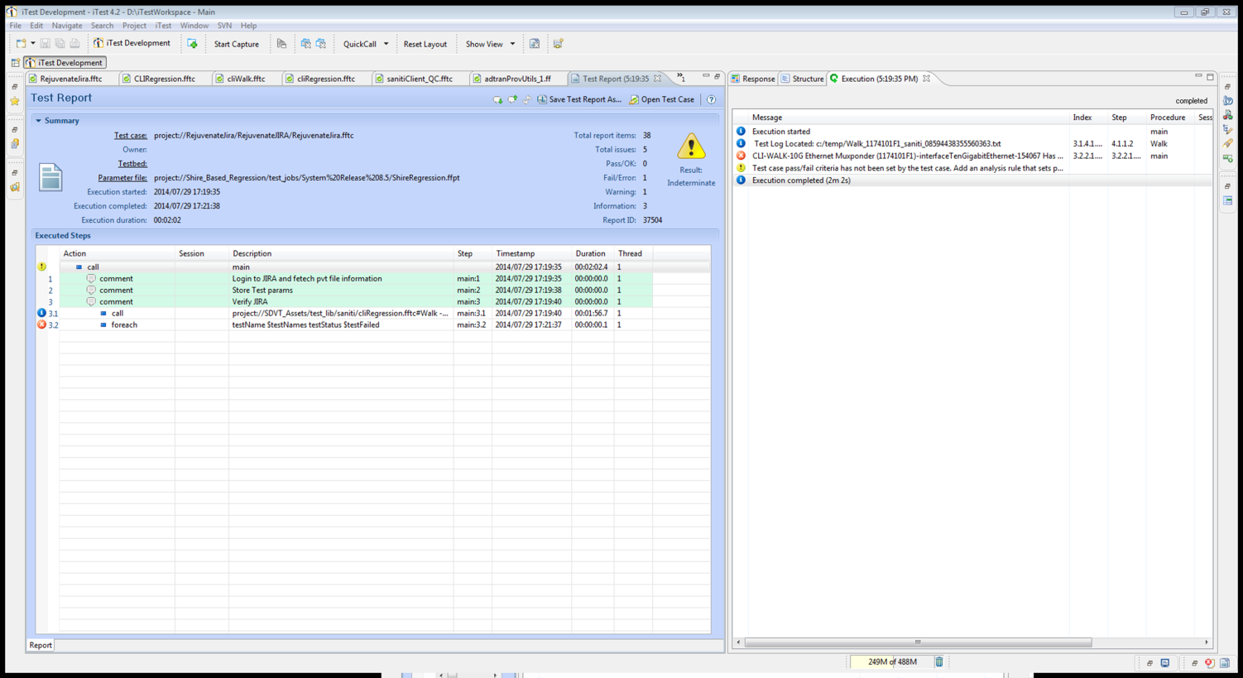
Advantages
 | Manual Approach | Rejuvenate JIRA | Saving
Single Walk Test | 3-4m | 2m 2s | ~1M
1 X 60 | 60X4~= 240m | 60X2~= 120m | ~120M

